Slide 1

Week #7
AI Academy®
1
Day 1:
What is Logistic Process?
Understanding & Selecting Process
Selecting Supply Chain
Reviews & Feedbacks

Slide 2
Week #7
AI Academy®
Logistics Process:
Inbound Logistics Process
Outbound Logistics Process
Procurement Logistics Process
Reverse Logistics Process
Manufacturing Logistics Process
Distribution Logistics Process
2

Slide 3
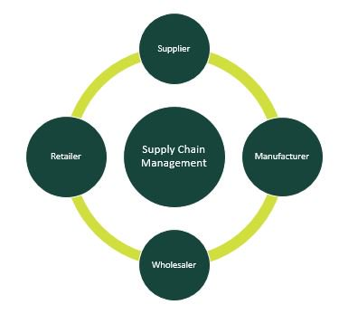
Week #7
AI Academy®
Supply Chain Management Network:
3

Slide 4
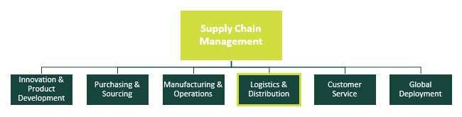
Week #7
AI Academy®
Logistics if in Supply Chain Management:
4

Slide 5
Week #7
AI Academy®
5
Day 2:
What is Inventory Management?
Handling Inventory
Various Tools for Handling Inventory
Reviews & Feedbacks

Slide 6
Week #7
AI Academy®
Inventory Management:
Warehousing
Inventory
Stocking
Packing
Ordering
Cargo / Distribution
6

Slide 7
Week #7
AI Academy®
Inventory Management Do’s Techniques:
Minimum Order Quantity (MOQ)
ABC Analysis (Batch analysis)
Just-In-Time (JIT)
Safety Stock
FIFO & LIFO
Batch Tracking
Consignment (Local Store)
7

Slide 8
Week #7
AI Academy®
Inventory Management Don’ts:
Lack of Automation
Ignoring Market Demands & Trends
Under & Over Stocking
Inaccurate Data Entry
Never Make Assumptions
8

Slide 9
Week #7
AI Academy®
9
Day 3:
What is Order Processing?
Order Management
Strategies use in Different Business Models
Reviews & Feedbacks

Slide 10
Week #7
AI Academy®
Order Management:
An order management system (OMS) is a digital way to manage the lifecycle of an order. ¹ It tracks all the information and processes, including order entry, inventory management, fulfillment, and after-sales service. An OMS offers visibility to both the business and the buyer.
10

Slide 11
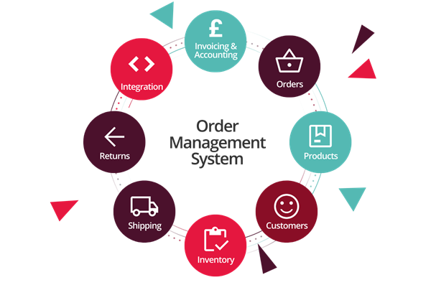
Week #7
AI Academy®
11

Slide 12
Week #7
AI Academy®
12
Day 4:
Defining Importance
Local Customer Support
Global Customer Support
Reviews & Feedbacks

Slide 13
Week #7
AI Academy®
Customer Support:
Customer support is the process of solving any customer challenges and pain points immediately via phone, email, live chat, tickets, or social media. Customer support not only ensures a smooth user experience but also strengthens the trust and loyalty between a brand and its customers.
Customer Service vs Customer Support:
It’s about saying to a customer, “I have something for you,” instead of a customer saying, “I need something from you.”
13

Slide 14
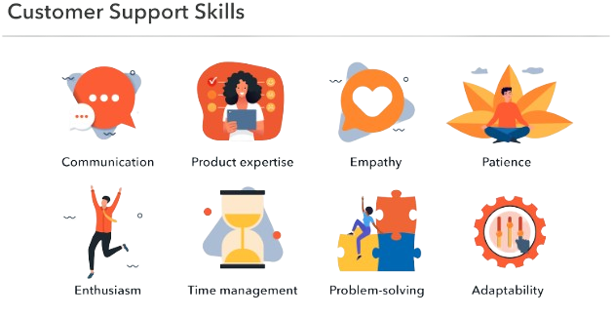
Week #7
AI Academy®
14

Slide 15
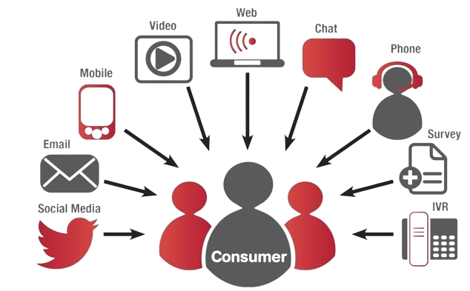
Week #7
AI Academy®
Customer Support Channels:
15

Slide 16
Week #7
AI Academy®
16
Day 5:
Strategies to Conclude Performance
Analysis
Metrics
Tracking's
Reviews & Feedbacks

Slide 17
Week #7
AI Academy®
Performance Analysis:
Performance Analysis is a specialist discipline involving systematic observations to enhance performance and improve decision making, primarily delivered through the provision of objective statistical and visual feedback.
Tracking Metrics:
Tracking performance metrics provides a way for businesses to measure growth and development. Productivity, profit margin, scope and cost are some examples of performance metrics that a business can track to determine if target objectives and goals are being met.
17

Slide 18
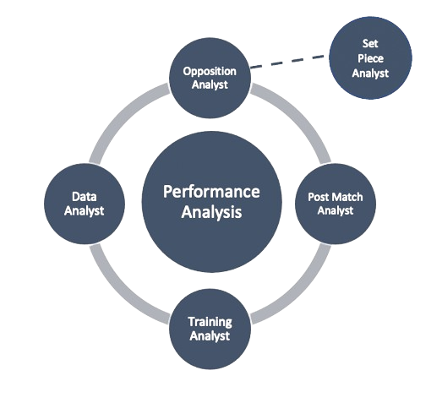
Week #7
AI Academy®
Performance Analysis:
18

Slide 19
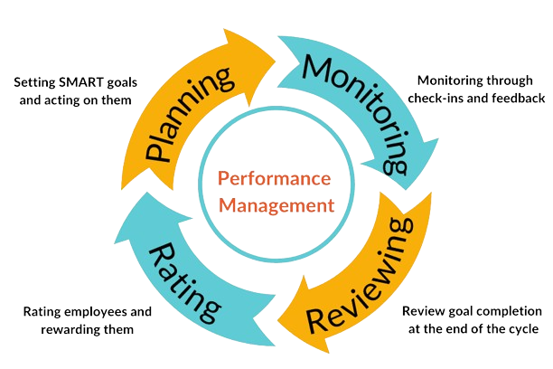
Week #7
AI Academy®
Performance Management:
19

Slide 20
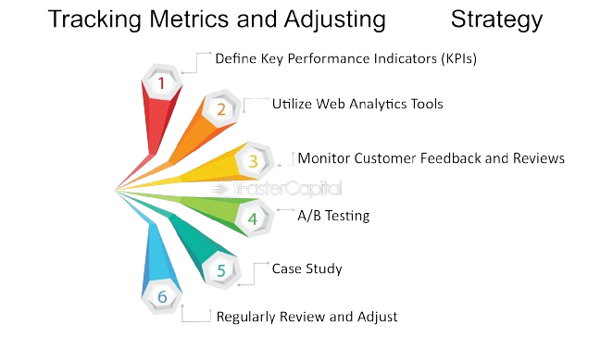
Week #7
AI Academy®
Tracking Metrics:
your
20

